Slide 1
Generalised additive models
Sophie Lee, PhD
Full resource, see: https://www.ncrm.ac.uk/resources/online/all/?id=20851
Notes:
Hello and welcome to this video introducing generalised additive model with me Sophie Lee

Slide 2
What are generalised additive models?
Statistical models that include smooth functions of covariates
Flexible alternative to generalised linear models (GLMs)
Allows for nonlinear relationships between outcome and covariate(s)
Notes:
Generalised additive models are statistical models that contain smooth functions of covariates that allow nonlinear relationships between an outcome of interest and one or more covariates. They offer a flexible alternative to the more traditional generalised linear approach that most people are more familiar with. GAMs are most useful where we wish to explore nonlinear relationships between variables.
On screen is the model equation for a generalised additive model. If you are familiar with linear models, the first half of this should be fairly recognisable

Slide 3
What are generalised additive models?
Notes:
That is because the majority of this equation is the same as the traditional linear modelling approach. The left-hand side of this equation is the expected outcome of interest, mu, transformed using a link function determined by the model choice. For example, a normal model would use the identity function, poisson would apply a log function, et cetera
The second element is alpha 0, the intercept or baseline term. This is the expected outcome where all other values are 0. Next, we have a linear combination of explanatory variables, x, multiplied by coefficients alpha. These model linear relationships between the variables and the outcome, after adjusting for other variables in the model. The final term is the part that differs from a linear model: the smooth functions. Here, a smooth function is applied to one or more explanatory variable.

Slide 4
Smooth functions?
The inclusion of smooth functions makes models more flexible
Flexibility comes at a cost:
How should these functions be specified?
How smooth or wiggly should the function be?
Must avoid overfitting the data
Notes:
These smooth functions make the modelling framework far more flexible but this does come at a cost. The inclusion of smooth functions requires some specification of the types of functions. We also must find a way to decide how smooth or wiggly this function should be. This is particularly important as an over wiggly function could lead to a model that overfits the data and is no longer useful in making inferences

Slide 5
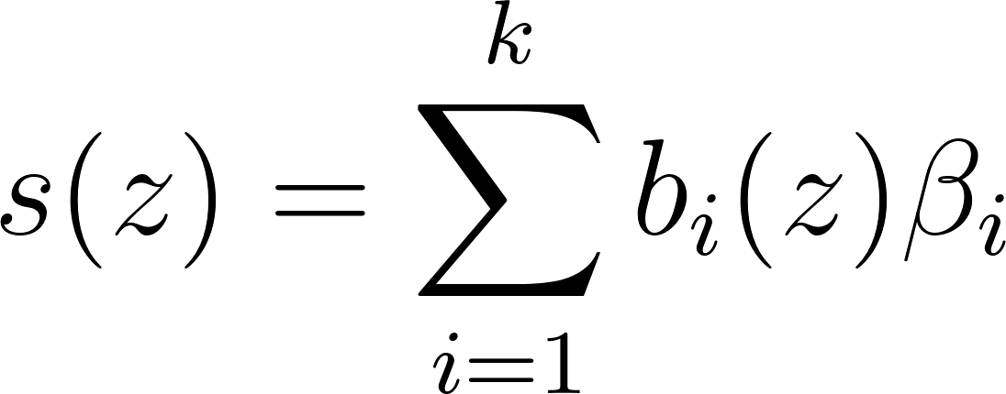
Smoothing splines
GAMs use smoothing splines to construct smooth functions
Linear combination of basis functions and coefficients:
Notes:
To address these concerns, GAMs use smoothing splines to construct the smooth functions. These splines can be broken down further as a linear combination of known basis functions, applied to intervals of the observed covariate, and unknown coefficients, beta, which are estimated from the data

Slide 6
Smoothing splines
Basis functions:
Chosen before model fitted
Based on expected nature of relationship
Coefficients:
Estimated from the data
Adds weighting to the basis functions
Notes:
Basis functions are chosen before the model fitted and are based on the type of smoothing spline we decide to use. Each smoothing spline has a different basis function. The choice depends on the expected complexity of the relationship, and whether the smooth contains a single variable, or is generated across multiple dimensions.
Coefficients are estimated similarly to other regression coefficients based on the data. These act as weights on the basis functions and determine the shape of the function

Slide 7
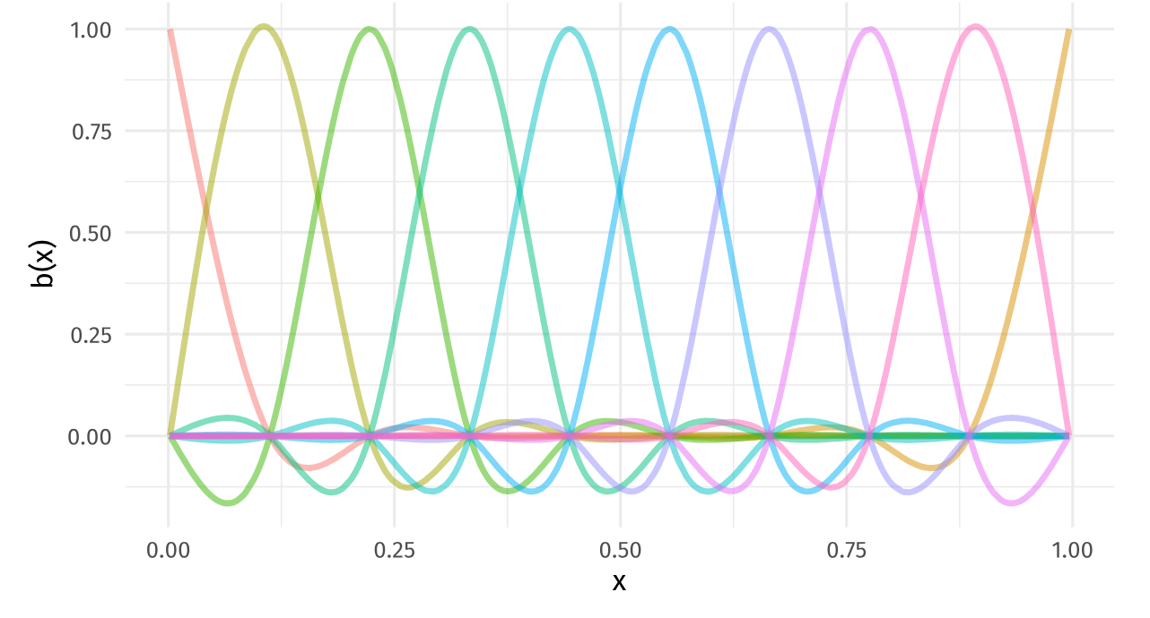
Source: https://gavinsimpson.github.io/physalia-gam-course/day-2
Notes:
For example, where we have a fairly simple relationship between a single variable and the outcome, we may consider a cubic smoothing spline. The basis function for the cubic spline is the cubic function, shown here applied across the covariate, x. This shows the basis functions before they have been weighted by coefficients

Slide 8
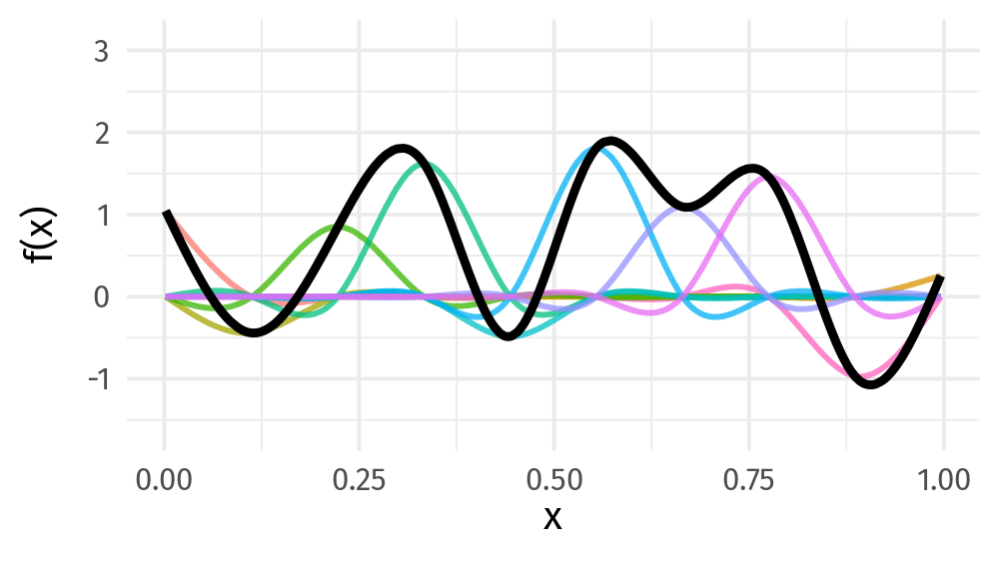
Source: https://gavinsimpson.github.io/physalia-gam-course/day-2
Notes:
This animation shows different combinations of cubic basis functions and coefficients. As you can see, the coefficients completely change the shape of the curve, meaning that the same basis function can be used across many different situations and produce completely different pictures.
So how do we (or rather, the software we are using) estimate these coefficients?

Slide 9
Smoothing splines
Coefficients estimated by maximising penalised log-likelihood
Penalty ensures model doesn’t overfit the data
λ: smoothing penalty parameter
λ→∞: straight line
λ = 0: unpenalised piecewise function
Notes:
There are many different ways that can be used to calculate these coefficients but the general consensus between GAM experts is that penalised log-likelihood produces the most stable results. This approach involves assigning a penalty to the log-likelihood of a model that ensures the model does not overfit the model. Without this, the model would most likely produce a smooth that interpolates all points in the sample.
The penalty consists of two terms: lambda and W. Lambda is known as the smoothing penalty parameter. The larger lambda becomes, the closer the smooth is to a straight line. The closer to 0, the more wiggly it becomes

Slide 10
Smoothing splines
Coefficients estimated by maximising penalised log-likelihood
Penalty ensures model doesn’t overfit the data
λ: smoothing penalty parameter
W: measure of ‘wiggliness’
Notes:
The second component, W, is a measure of model wiggliness, and is based on the integral of the second derivative of the smooth function squared.

Slide 11
How wiggly?
Wiggliness is determined by number of knots (turning points)
Larger k, more wiggly the smooth
Notes:
Alongside the basis functions and coefficients, another element that controls the shape of smooth functions is the number of knots, how many basis functions and coefficients make up the smooth function. These can also be thought of turning points in the smooth. For any smooth function, the higher k, the more wiggly the smooth function becomes

Slide 12
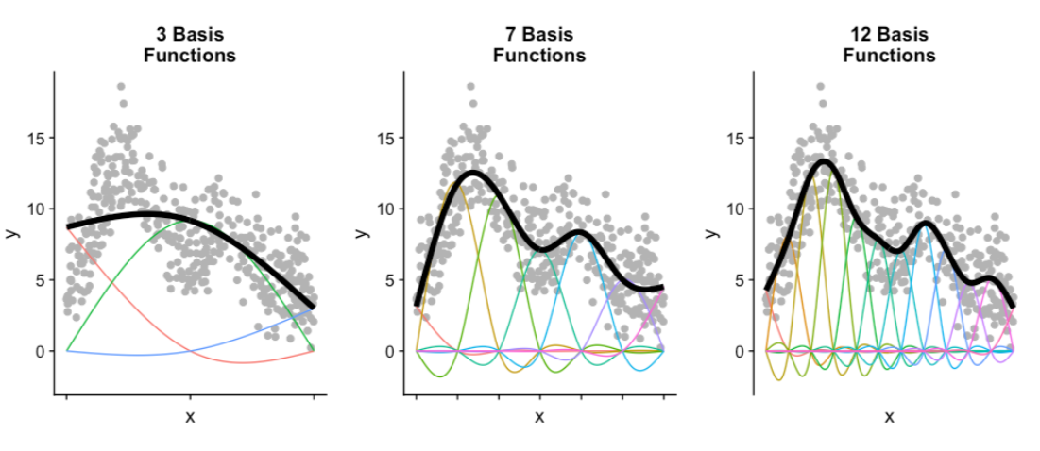
Source: https://noamross.github.io/gams-in-r-course/chapter1
Notes:
These three plots show smooth functions fitted to the same data with a different number of knots. K = 3 is too smooth to pick up the relationship, whereas 12 is unnecessarily wiggly. The middle plot shows the situation we are aiming for: enough knots to explain the data, without overfitting it

Slide 13
How wiggly?
k is estimated alongside the model fit
In reality, specify a maximum number of knots
Larger maximum - higher computational cost
Notes:
We don’t need to specify k, it is estimated alongside the model fit. In reality, we need to provide the software fitting the model with a maximum number of knots. Once the maximum number is high enough, increasing it further will not change the function, but will rapidly increase the computational cost. Therefore, our aim when specifying k is to choose a number large enough, without slowing the model fit down too much! This will be demonstrated further in video 3

Slide 14
www.ncrm.ac.uk
Notes:
Thank you for listening, the following videos will show an application of GAM to real data using the mgcv R package

